Slide 1

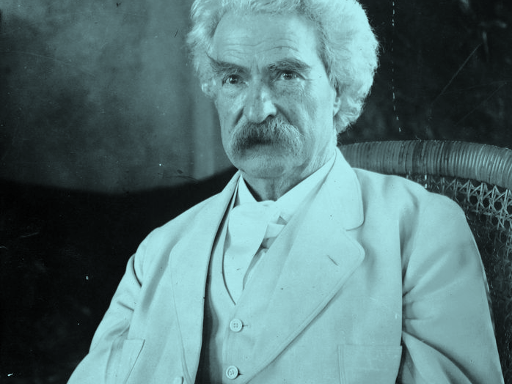
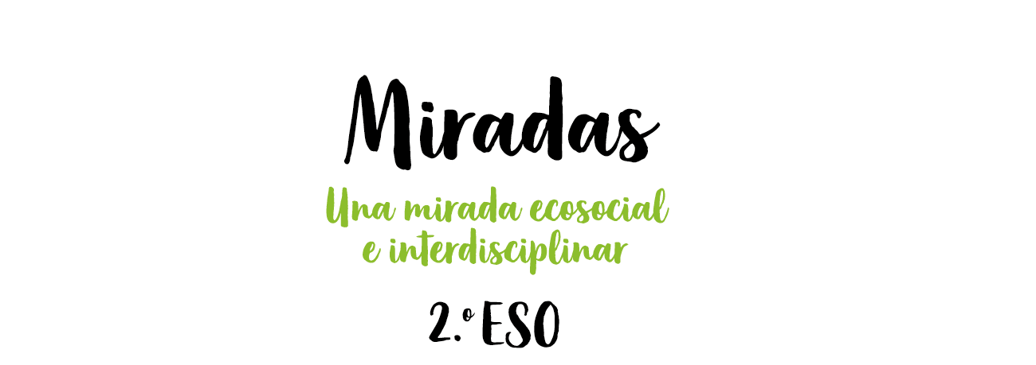
Mark Twain
“A LIE CAN TRAVEL HALFWAY AROUND THE WORLD WHILE THE TRUTH IS PUTTING ON ITS SHOES”

Slide 2
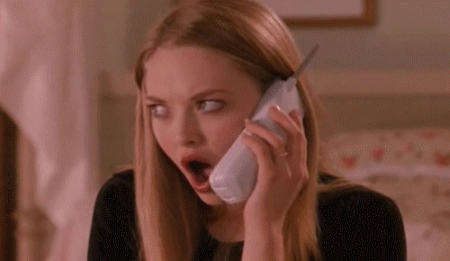
WARM-UP
TIME FOR TELEPHONE
Notes:
Share a random thought, fact, or phrase with one student in the class. Have that student turn around and whisper what they heard to the person behind them. Keep following this pattern until the last student hears the sentence or phrase. Have that student share what they heard with the rest of the class. Compare what the last student said with the original secret you shared.
<número>

Slide 3
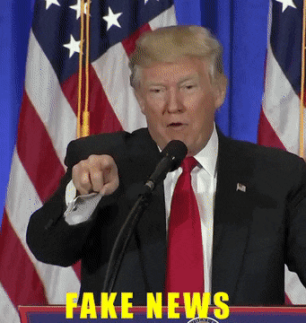
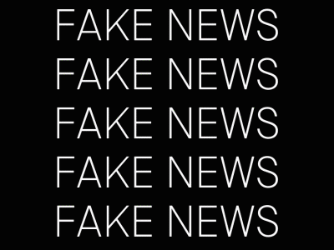
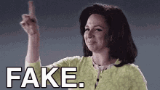
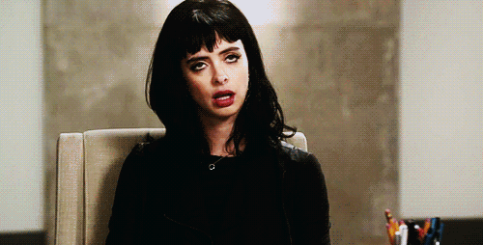
Notes:
Tell the class: “Today, we are going to talk about fake news.” It’s a phrase that was made popular during Donald Trumps presidency in the United States, but what does it mean? Give the students a few minutes to respond.
<número>

Slide 4
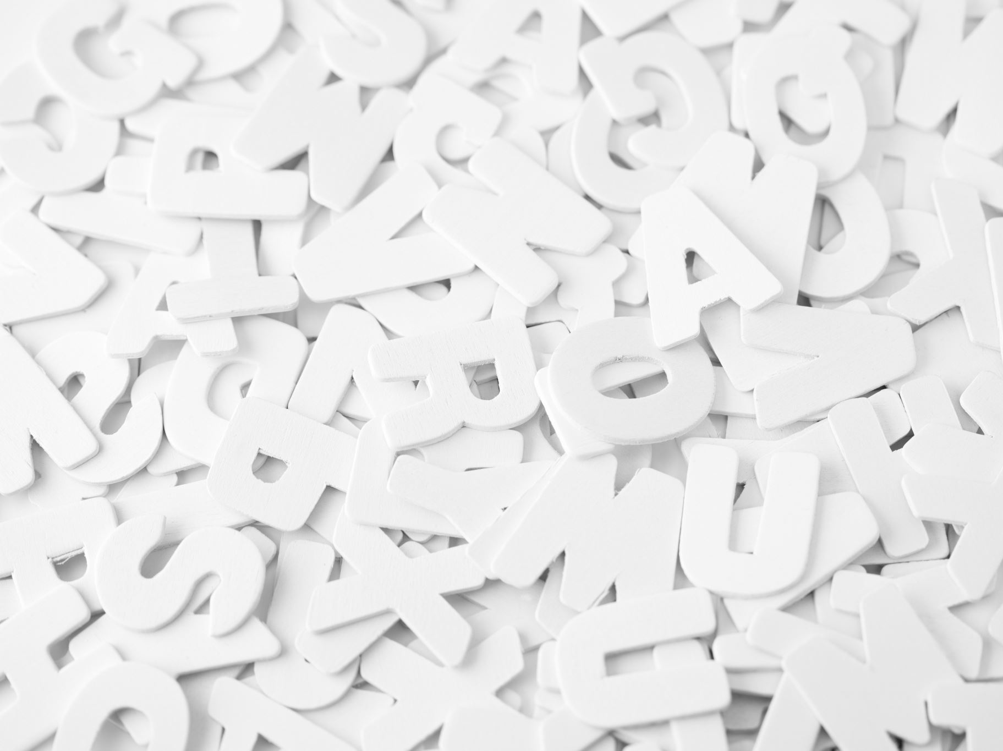




VOCABULARY
Study the sentences below. Use the sentence to find the meaning of the underlined word.
We should not tolerate this biased media coverage.
The newspaper has been accused of publishing sensationalist stories of the murders.
The report presented fabricated evidence.
There are so many pseudoscientific beliefs, for example, astrology.
Judges need to be impartial to make objective decisions.
Notes:
Give students 5 minutes to examine these sentences and try to find their own definition for each word.
<número>

Slide 5

VOCABULARY
Biased sensationalist fabricate
pseudoscientific impartial
a) _____________ : presenting stories in a way that is intended to provoke public interest or excitement, at the expense of accuracy.
b) _____________ : invent or concoct (something), typically with deceitful intent.
c) _____________ : treating all rivals or disputants equally; fair and just.
d) _____________ : unfairly prejudiced for or against someone or something.
e) _____________ : falsely or mistakenly claimed or regarded as being based on scientific method.
Notes:
Biased - unfairly prejudiced for or against someone or something.
Sensationalist - presenting stories in a way that is intended to provoke public interest or excitement, at the expense of accuracy.
Fabricate - invent or concoct (something), typically with deceitful intent.
Pseudoscientific - falsely or mistakenly claimed or regarded as being based on scientific method.
Impartial - treating all rivals or disputants equally; fair and just.
<número>

Slide 6

Discuss the following questions?
How do you keep up with the news?
Do you trust the information you get? Is the media coverage in your country biased?
How can you know that the information you've read/heard is not fabricated?
What do you know about fake news?
Notes:
Give students 5 minutes to discuss in pairs. Then, discuss the questions as a class.
<número>

Slide 7
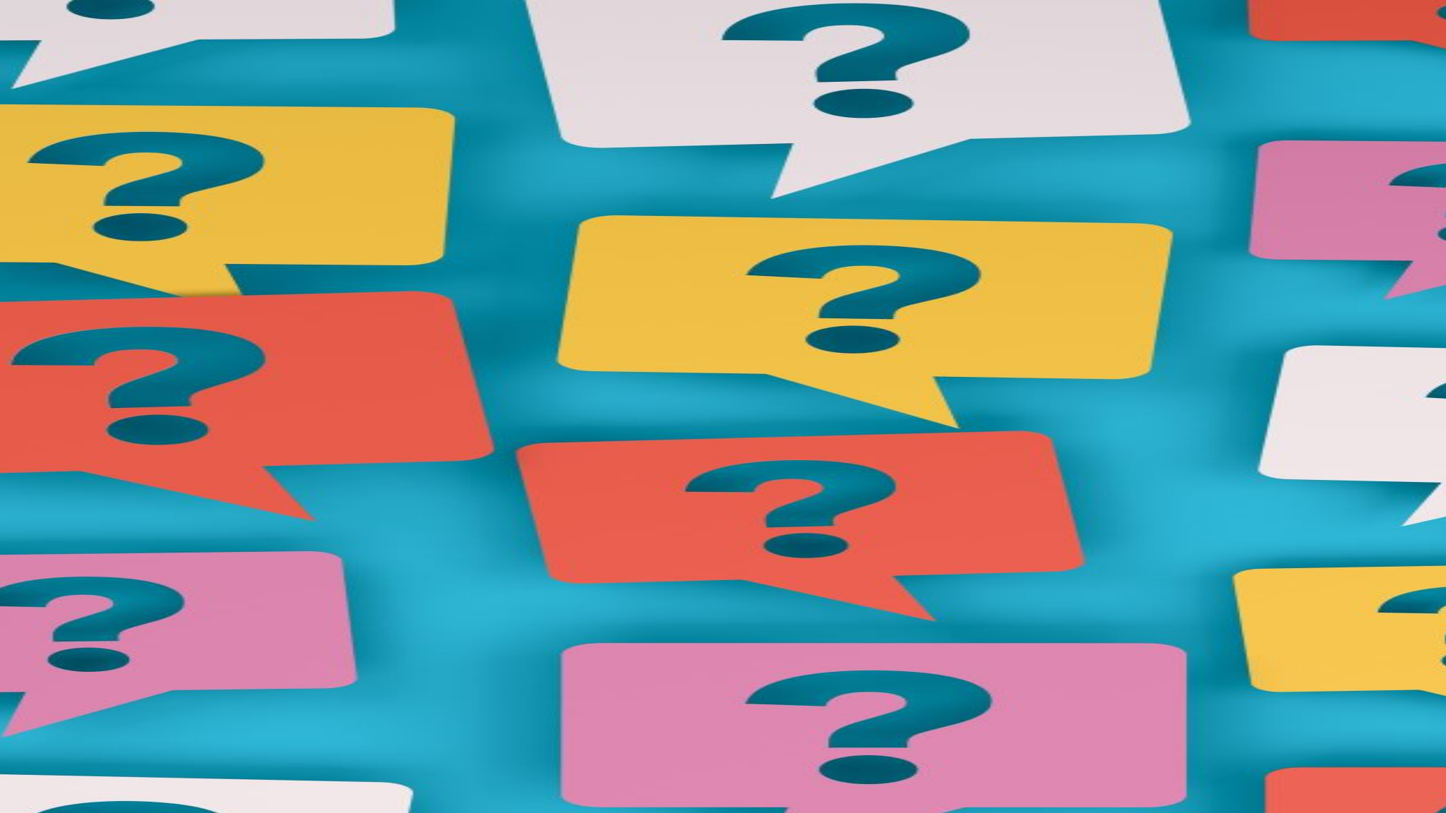
3. Read the text below and answer the questions below.
Circular reporting can occur when: " (...) publication A publishes misinformation, publication B reprints it, and publication A then cites B as the source for the information. It's also considered a form of circular reporting when multiple publications report on the same initial piece of false information, which then appears to another author as having been verified by multiple sources.“
1. In your own words, what is circular reporting?
2. How do you think it can be avoided?
3. How can it affect our everyday lives?

Slide 8
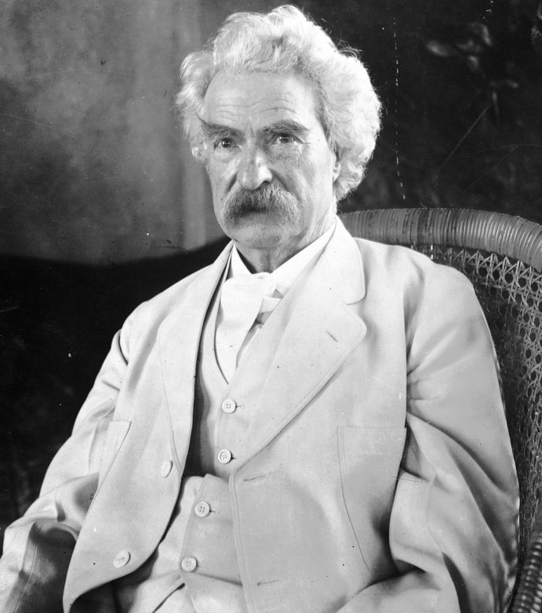
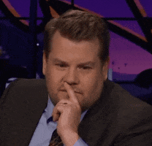
Let’s get back to Mark Twain?
https://youtu.be/cSKGa_7XJkg
“A LIE CAN TRAVEL HALFWAY AROUND THE WORLD WHILE THE TRUTH IS PUTTING ON ITS SHOES”
Hmmmm…….
Notes:
<número>

Slide 9
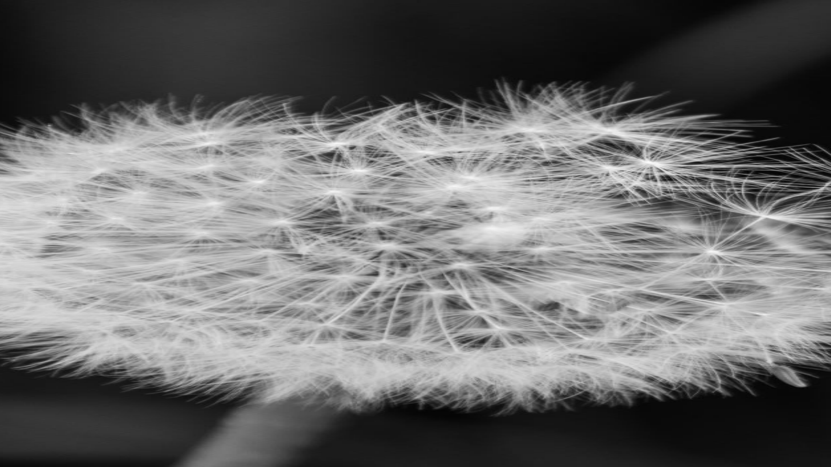
Things that
make you go hmm…
What examples of circular reporting does the speaker mention?
How do wikis contribute to circular reporting?
What should we do to avoid circular reporting according to the video?
What impact do you think fake news sites have on elections?
Have you seen people sharing fake news on social media pages? If so, what types of behaviors did you notice when it happened?
What impact do you think fake news has had on you or on people in your life?

Slide 10
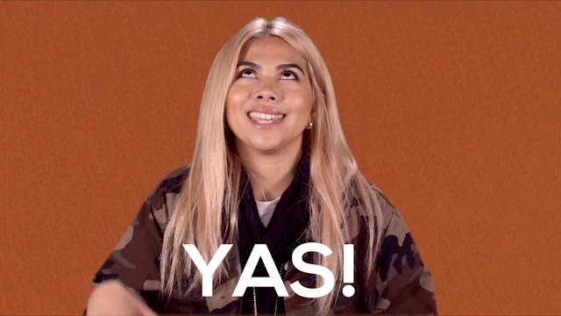
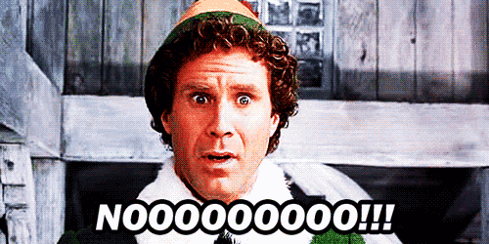
TRUE OR FALSE
CAN IT BE!!!

Slide 11
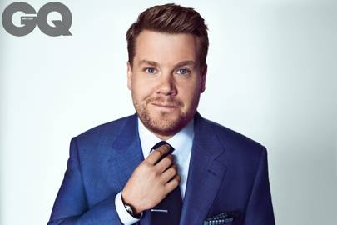
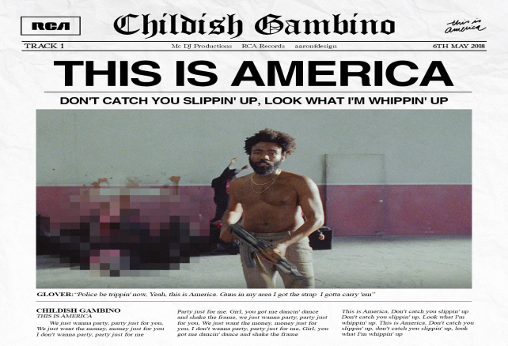
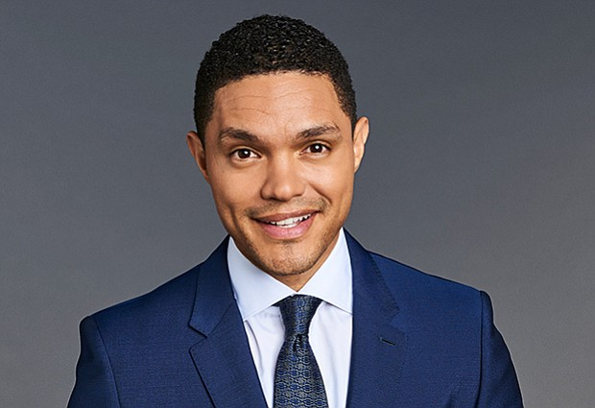
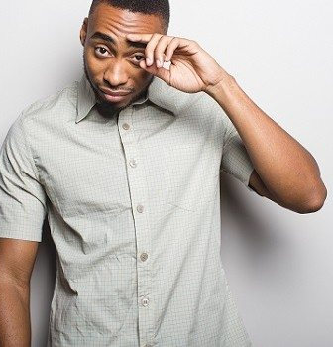
CAN WE TRUST THE MEDIA?
MUSIC VIDEOS
https://youtu.be/p6d2mam4QuE
https://youtu.be/VYOjWnS4cMY
https://youtu.be/tKfIkcLVRO8
LATE NIGHT SHOWS
https://youtu.be/dRl8EIhrQjQ

